Slide 1
MTN-028
Clinical Considerations

Slide 2
Overview of Discussion Topics
Baseline Medical/Medication History
Physical/Pelvic Exams
STI/RTI/UTI Management
Product Use Management
Prohibited Practices Management
Follow-up Medical/Medication History

Slide 3
Baseline Medical History
When:
  Obtained starting at the Screening Visit
  Reviewed/updated at enrollment visit, prior to randomization
Purpose:
  To establish eligibility
  To document relevant baseline medical history and conditions for comparison during follow-up

Slide 4
Baseline Medical History:
What?
Past medical history
Past problems, including those where medication was taken for an extended period of time
Previous surgeries
Gynecologic history
Allergies (drugs, latex, seasonal)
Any current symptoms/conditions she is having

Slide 5
Baseline Medical History:
How?
Baseline Medical History Questions Sheet
Notes:
looks the same for 027 and 028, right?

Slide 6
Baseline Medical History:
How?

Slide 7
Baseline Medical History:
How?

Slide 8
Baseline Medical History:
How?

Slide 9
Baseline Bleeding
Baseline Menstrual History
  Incorporated into Baseline Medical History
  Moving away from strict ranges for menses
  Moving towards FGGT definitions of bleeding abnormalities

Slide 10
Baseline Medical History:
Where
Recommend use of Baseline Medical History Questions sheet in conjunction with the Pre-existing conditions CRF and/or chart notes to guide and document medical history taking.
Relevant* items should be recorded on Pre-Existing Condition CRF
*hospitalizations; surgeries; allergies; conditions requiring prescription or chronic medication (lasting for more than 2 weeks); and any conditions currently experienced by the participant.

Slide 11
Baseline Medication History
Documented at Screening
Reviewed/updated at Enrollment
Cross referenced with medical history
Probe for any medications taken for all ongoing symptoms/illnesses/conditions

Slide 12
Pre-Existing Conditions
Comprehensive Snap-Shot at Enrollment
  Information obtained from history taking
  Abnormal screening labs
  Abnormal physical exam findings
  Abnormal pelvic exam findings

Slide 13
Follow-up Medical History
Medical history must be updated at all follow-up visits
  Are previously reports conditions ongoing?
  Are there new or worsening symptoms?
Site clinicians can use their expertise to elicit complete and accurate information
  How are you?
  At your last visit, you reported X. Has this resolved?
  Any current symptoms?
  Any issues since your last visit?
  Have you taken any medications since your last visit?

Slide 14
Follow-up Medical History
Bleeding
Consider asking targeted gynecologic questions
  When was your LMP?
  Any gynecologic problems since your last visit?
  Have you been bothered by abnormal discharge, pain or bleeding?
Notes:
Targeted gynecological questions (e.g. When was your last menstrual period? Would you say this is typical for you? Have you experienced any gynecoglogic problems since your last visit, for example, have you been bothered by abnormal discharge, pain, or bleeding?)

Slide 15
Follow-up Medical History Documentation
Review MUST be documented
  Chart notes or
  Site specific tool
Date of LMP should be recorded
All newly-identified symptoms and conditions will be documented on the Adverse Experience Log (AE-1) CRF

Slide 16
Physical Examination:
Timing and Documentation
When:
  Required at every scheduled study visit
  Additional clinical assessments may be performed at the discretion of the examining clinician in response to symptoms or illnesses present at the time of the exam.
Documentation:
  Physical Exam CRF is recommended source document
  Transcribe medically-relevant abnormal findings at Screening or Enrollment onto PRE CRF
  During follow-up, transcribe abnormalities onto AE CRF as needed
All visits – cross-reference with Con Meds Log

Slide 17
Physical Examination Components
Vital/General Assessments
Clinical Assessments
Temperature
Blood pressure
Pulse
Respirations
Weight
Height*
General Appearance
Abdomen
Lymph nodes
Neck
Heart
Lungs
Extremities
Neurological
Skin
Notes:
A comprehensive physical examination is required at Screening and Enrollment. A modified/targeted physical examination (to include at a minimum assessment of general appearance, weight, and vital signs) is required at all other follow-up visits

Slide 18
Pelvic Examination
Required at every scheduled visit
Pay careful attention to differences in specimen collection at different visits
Pay careful attention to the order of specimen collection
To be performed with the ring in place
Ideally should not be done during menses
Notes:
If applicable, IVR removal and re-insertion during pelvic examination and duration of removal should be documented on the Pelvic Exam Ring Assessment CRF.

Slide 19
Pelvic Exam Checklist

Slide 20
Pelvic Examination Potential Challenges
Discomfort with ring in place
  Ideally, pelvic should be done with ring in place
  If ring in situ causes discomfort or is a visual impairment, the clinician can remove
  Removal should be documented on Pelvic Exam Ring Assessment CRF
Exams during menses
  Reschedule Screening
  Reschedule Enrollment if menses expected days 1-7
  Continue with exams if menses occurs during follow-up visit
    Notify management team if menses occurs day 1-7
    Notify management team if ppt declines exam

Slide 21
Pelvic Exam Terminology
Use terms from the Pelvic Exam CRF or FGGT
Use routine QC/QA opportunities to help ensure consistency of terminology across staff and exams
Common Pelvic Finding Terms:
  Erythema, Edema, Petechiae, Ecchymosis, Peeling, Ulceration, Abrasion and Laceration
Notes:
Items in red impact product use per protocol section 9.6

Slide 22
Pelvic Examination
Two person team: examining clinician and assistant
Ensure all possibly-required supplies and paperwork are easily accessible in exam room
Review specimen collection requirements for each visit in preparation for each exam
To be performed after the ring comes out.
Pay attention to where the ring is sitting in the vagina on removal
Pay careful attention to the required sequence of swab collection and required handling of each swab

Slide 23
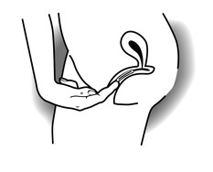
VR Placement Check
On digital (bimanual) exam, ring is proximal to the introitus and behind the pubic bone
Notes:
Participant must demonstrate the ability to insert and remove the ring. Clinician must perform digital exam to check ring placement
At each visit, following insertion of the vaginal ring, the study clinician or designee should check placement of the vaginal ring, regardless of who inserted it, to confirm correct placement. The following is the procedure that the IoR or designated clinic staff should use to verify ring placement:
• After ring placement, the participant should walk around prior to verification of correct ring placement.
• The participant should then lie comfortably on the examination table in supine position (on her back).
• Upon genital inspection, the ring must not be visible on the external genitalia. If the ring is visible, the placement is not correct.
• The ring should not press on the urethra.
• On digital or bi-manual examination, the ring must be placed at least 2cm above the introitus beyond the Levator Ani muscle.
• If, on inspection, the ring is found to be inserted incorrectly, the ring should be removed and reinserted correctly by the participant or the study clinician.
After correct placement is confirmed, the clinician should ask the participant to feel the position of her ring. This will help ensure that she understands what correct placement feels like, should she need to check this between study visits.
Placement check is required at every follow-up visit in which a ring is dispensed. How will this impact study flow?

Slide 24
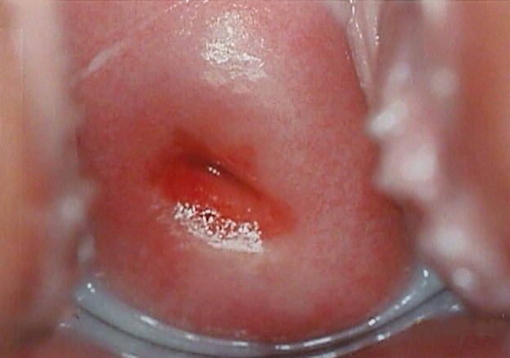
Measuring Cervical Ectopy

Slide 25
Pelvic Exam Terminology
Use terms from the Pelvic Exam CRF or FGGT
Use routine QC/QA opportunities to help ensure consistency of terminology across staff and exams
Common Pelvic Finding Terms:
  Erythema, Edema, Petechiae, Ecchymosis, Peeling, Ulceration, Abrasion and Laceration
Notes:
Some of the items in bullet #3 may impact product use per protocol section 9.6

Slide 26
Epithelial Disruption
Superficial epithelial disruption
  Does not penetrate into the subepithelial tissue
Deep epithelial disruption
  Penetrates into and exposes subepithelial tissue and possibly vessels
  If bleeding from finding is present, disruption should be recorded as deep when in doubt
Notes:
Extent of epithelial disruption helps to distinguish between findings (superficial vs deep).

Slide 27
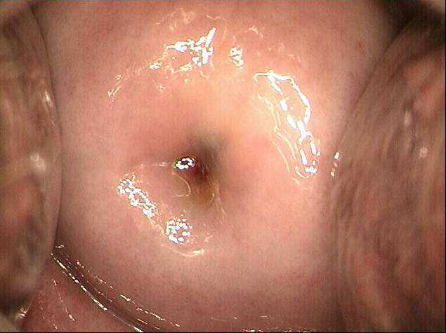
Normal Cervix
Mucosa
  Typically uniformly pink
  Epithelium intact
  Vessels intact
Normal variants are not lesions
  Gland openings
  Scarring from cone biopsies

Slide 28
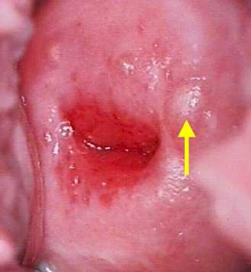
Normal Findings
Nabothian cysts

Slide 29
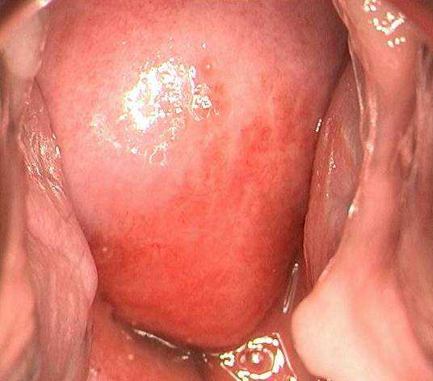
Erythema
Reddened areas
  Margins may or may not be clearly defined
  Epithelium intact
  Vessels intact

Slide 30
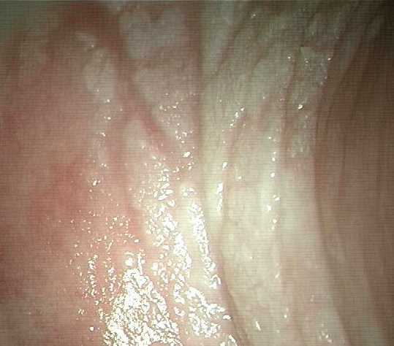
Edema
Epithelium
  Intact
  Swollen
Vessels
  Intact
Color
  Normal or pale white

Slide 31
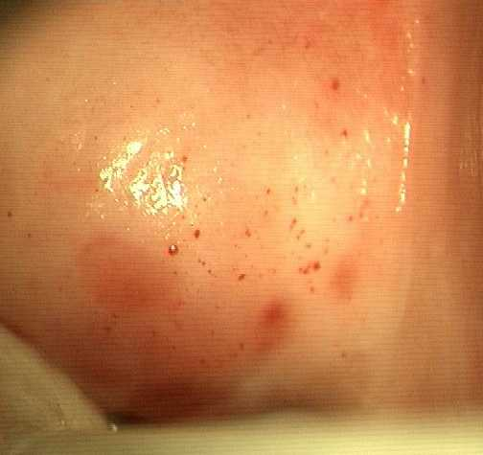
Petechiae
Punctate red areas
Individual or group
Epithelium intact
Vessels disrupted
Diameter ≤3mm
Color of finding is red or purple

Slide 32
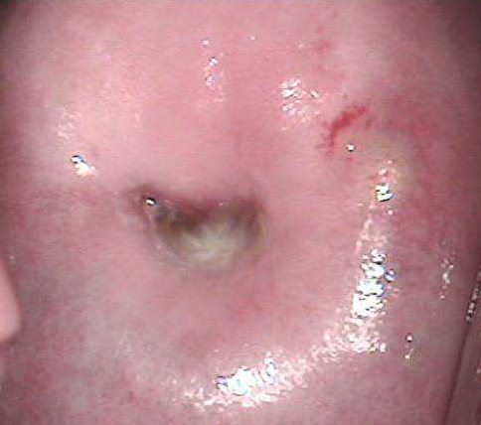
Ecchymosis
Epithelium intact
Vessels disrupted
Size >3mm
Color is red or purple

Slide 33
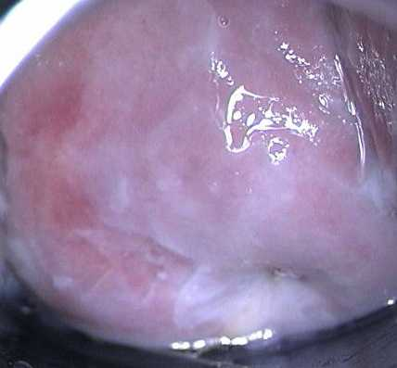
Peeling
Epithelium disrupted but superficially
Vessels intact
Fragment may remain attached to area of peeling
Generally well-demarcated
Underlying epithelium appears normal

Slide 34
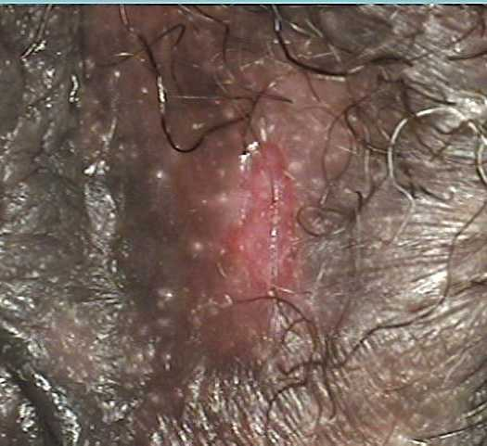
Ulceration
Disrupted epithelium
  Superficial or deep
Vessels intact or disrupted
May include sloughing
Sharply demarcated outline

Slide 35
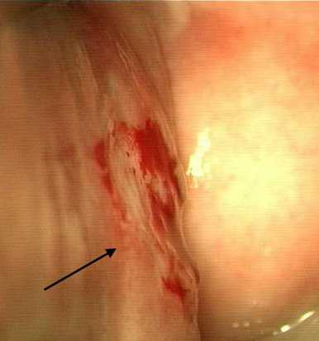
Abrasion
Epithelium disrupted
  Superficial or deep
Vessels intact or disrupted
Diffuse or poorly demarcated outline

Slide 36
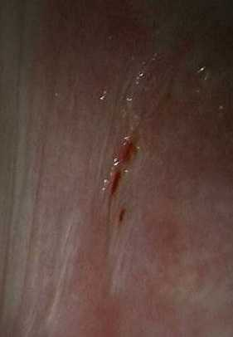
Laceration
A “cut” or “fissure”
Epithelium disrupted
  Superficial or deep
Vessels intact or disrupted
Appears to be linear “pulling apart” or wearing away of tissue

Slide 37
STI/RTI Management
STIs/RTIs should be managed per CDC guidelines
Participants diagnosed during screening with an RTI/UTI requiring treatment may be enrolled after treatment is complete provided all symptoms have resolved
  To enroll, participant: Must complete treatment, symptoms must be resolved and be within 45 days of obtaining IC
Note: GC/CT/Syphilis diagnosis is exclusionary, regardless of treatment
If diagnosed during follow up (AE), must be documented and followed to resolution.
Provide directly observed single dose regimens whenever possible
  Document all treatments taken on Con Meds Log
Notes:
Exception: Asymptomatic candidiasis and asymptomatic bacterial vaginosis do not require treatment and are not exclusionary.

Slide 38
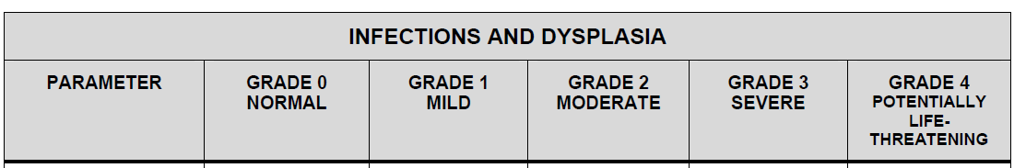
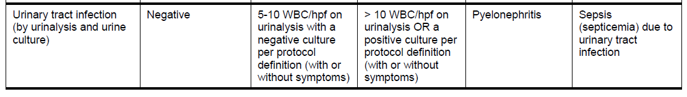
UTI Management
UTI can be treated based on symptoms
If suspected, send urine culture and urine microscopy
Grade UTI per FGGT
Initially report AE as symptoms
If findings confirm, UTI, update the AE CRF
If findings don’t support UTI diagnosis, keep symptoms as AEs

Slide 39
MTN 028 Urine Dip
Urine dipstick collected at screening and D28
Doesn’t directly impact eligibility
Doesn’t directly impact product hold
Please note:
  LE and nitrate are not gradeable per the FFGT
  Protein and glucose are gradeable
  If clinically significant, investigate (3+ blood)

Slide 40
Vaginal Discharge Management
Thoroughly evaluate all complaints and/or findings of abnormal vaginal discharge
Treatment for ‘abnormal vaginal discharge’ will depend on: what the underlying diagnosis is and whether the participant is symptomatic
  If STI is identified, offer Rx regardless of symptoms
  If RTI is identified, provide Rx only if symptomatic
On the CRF, distinguish whether the discharge was initially reported by the participant (“vaginal discharge by participant report”) or noted only on pelvic exam by the clinician (“vaginal discharge-clinician observed”)
  Example: Clinician observed vaginal discharge reveals asymptomatic bacterial vaginosis or asymptomatic yeast, an AE Log CRF should document “vaginal discharge-clinician observed”
  Even though asymptomatic yeast and bacterial vaginosis are not considered Adverse Events per protocol, in these instances, the clinician observed vaginal discharge should be captured as an Adverse Event.

Slide 41
Product Use Management
Identify the conditions that would require a product hold or discontinuation
Review conditions that require follow up per protocol before product resumed

Slide 42
Product Hold vs. Permanent Discontinuation
Clinical Holds/Discontinuations = Clinician Initiated
Some product holds will be temporary, with product use resumed after time has elapsed
  Deep epithelial disruption
Some holds will turn into permanent discontinuations
  Example: Deep epithelial disruption which has worsened after 3-5 days (after consultation with PSRT)
Notes:
If the site opts to hold product for a reason not explicitly stated in the protocol, they should notify the PSRT. They should hold product and submit a PSRT query (don’t wait for a response) prior to holding product.

Slide 43

Criteria for Permanent Discontinuation of Study Product
Exposure to or acquisition of HIV-1 infection
Pregnancy
Breastfeeding
Notes:
For those who acquire HIV study product should be held beginning immediately upon recognition of the first reactive rapid HIV test.
Note that reported PEP or PrEP use will also likely result in a product hold as part of investigator discretion, consult the PSRT should this be reported.

Slide 44
MTN-028
Product Use Management: Participant Non-compliance or other safety concerns
HOLD product if a participant is unable or unwilling to comply with required study procedures, or otherwise might be put at undue risk to her safety and well-being by continuing product use, according to the judgment of the IoR/ designee.
CONSULT the PSRT on all product holds instituted for this reason for further guidance on resuming product use, continuing the temporary hold, or progressing to permanent discontinuation.
If the underlying reason for the product hold resolves, CONSULT the PSRT to resume study product at that time.
Protocol Reference: Section 9.3

Slide 45
MTN-028
Product Use Management: Grade 1 and Grade 2 Adverse Events
AE
addressed
in protocol section
9.5 or 9.6?
no
CONTINUE product.
yes
Follow
relevant protocol
section
Protocol Reference: Section 9.4

Slide 46
MTN-028
Product Use Management: Grade 3 Adverse Events
START
AE
addressed
in protocol section
9.5 or 9.6?
HOLD
product.
Notify
PSRT.
no
Assess AE relationship to product
not related
yes
related
Follow
relevant protocol
section
Discontinue Study Product. Notify PSRT.
Protocol Reference: Section 9.4

Slide 47
MTN-028
Product Use Management: Grade 4 Adverse Events
AE
addressed
in protocol section 9.5 or 9.6?
Discontinue
product.
Notify
PSRT.
no
yes
Follow
relevant protocol
section
Protocol Reference: Section 9.4

Slide 48
MTN-028
Product Use Management: Sexually Transmitted Infections and Reproductive Tract Infections
CONTINUE product, unless other product hold guidelines apply.
Consult the PSRT if a temporary hold is deemed necessary and instituted by the IoR/designee.
Vaginally applied medications should not be used whenever possible, and oral or parenteral medications should be used instead.
*Treat per CDC guidelines, using observed single dose regimens whenever possible.
Protocol Reference: Section 9.5
Notes:
If vaginal medication is required, consult the PSRT.

Slide 49
MTN-028
Product Use Management: Superficial epithelial disruption (abrasion/ peeling)
If condition worsens, temporarily HOLD product and consult the PSRT
CONTINUE product.
Perform naked eye exam.
Re-evaluate by speculum exam in 3-5 days.
Has it resolved?
yes
CONTINUE
product.
Protocol Reference: Section 9.5

Slide 50
MTN-028
Product Use Management: Deep epithelial disruption
Remove vaginal ring and if confirmed deep epithelial disruption by IoR/designee HOLD product.
Re-evaluate in 3-5 days.
Has the AE resolved?
Continue to
HOLD product.
CONSULT
PSRT. Treat per local standard of care.
Re-evaluate within 2-3 days.
Has the AE resolved?
no
Continue to
HOLD product.
CONSULT
PSRT regarding permanent discontinuation
no
yes
yes
RESUME
product.
RESUME
product.
HOLD
product.
CONSULT
PSRT.
Has the AE reoccurred?
Protocol Reference: Section 9.5
Notes:
Deep epithelial disruption can be due to ulcers or lacerations or deep abrasions.

Slide 51
MTN-028
Product Use Management: Localized erythema or edema (area < 50% of vulvar surface or combined vaginal and cervical surface)
If asymptomatic, reevaluate at next study visit.
If symptomatic, Re-evaluate in 3-5 days
CONTINUE product
Perform naked eye exam
If condition has not worsened significantly, continue ring use
If condition worsens significantly, temporarily HOLD product and consult the PSRT
Protocol Reference: Section 9.5

Slide 52
MTN-028
Product Use Management: Generalized erythema or severe edema (area > 50% of vulvar surface or combined vaginal and cervical surface affected by erythema)
HOLD product and perform naked eye exam.
Re-evaluate in 3-5 days.
Has the AE resolved?
Re-evaluate within 2-3 days.
Has the AE resolved?
Continue to
HOLD product.
CONSULT
PSRT. Treat per local standard of care.
no
no
yes
RESUME
product.
yes
RESUME
product.
Protocol Reference: Section 9.5

Slide 53
MTN-028
Product Use Management: Unexpected Genital Bleeding
CONTINUE product and perform naked eye exam
If determined to be due to deep epithelial disruption, follow those guidelines; otherwise continue study IVR use
Protocol Reference: Section 9.5

Slide 54
MTN-028
Product Use Management: Genital petechia(e), genital ecchymosis
CONTINUE product and perform naked eye exam
No further evaluation or treatment is required
Protocol Reference: Section 9.5

Slide 55
Permanent Product Discontinuation or Hold for Any Other Reason
Notify the PSRT
If due to AE, PSRT will likely ask you to follow until resolution or stabilization
Notes:
Stabilization is defined as persistence at a certain severity grade (above baseline) for two consecutive monthly evaluations

Slide 56
Prohibited Practices Management
Medications
  Certain CYP3A inhibitors and CYP3A inducers
    Single dose fluconazole is ok
  Vaginal medications (e.g. monistat)
  Female to male transition medications
  Temporary hold for prohibited medication use
    Consult PSRT, may resume when participant reports no longer taking the prohibited medication
Vaginal practices
  Receptive intercourse the entire study (from 5 days prior to enrollment)
  Tampons for 1st week and 24 hours prior to visit
  Vaginal devices (e.g. diaphragm)
Notes:
Note that reported PEP or PrEP use will also likely result in a product hold as part of investigator discretion, consult the PSRT should this be reported.

Slide 57
What are your questions?

